Slide 1
Wireless Security & Anonymous Communication
Security scanning and onion routing.
Have knowledge of threats in wireless communication. Understand how to secure wireless communication using encryption, MAC validation and authentication.
Tue Becher

Slide 2

Security update
http://watchguardsecuritycenter.com

Slide 3
Security Tools – Network monitor
Network monitor aka.
Network analyzer
Packet sniffer
Used to monitor and troubleshoot network traffic
Capture packets that pass through a network interface.
Normal operation only captures packets with destination matching the machine in question
Promiscuous mode enables capturing ALL packets passing the network node

Slide 4
Security Tools – Network monitor
Allow capture of all network traffic
Analyze captured traffic to reveal info transmitted in clear text.
Users on your network may be running rogue packet sniffers
experimenting out of curiosity
with malicious intent
How can you prevent this?

Slide 5
Vulnerability Scanning
Help you secure your network
Identify weaknesses in your system
Identify devices open to known vulnerabilities
Use tools to identify and fix weaknesses
Use the tools before the bad guys!!!

Slide 6
Vulnerability Scanning
Different methods
Analysis of windows registry
Check for missing patches etc.
Attempt to exploit known vulnerabilities
Issues:
May impact the devices targeted for scanning
Scan can be intrusive and cause system crashes
Trying to exploit a DoS vulnerability could make the system unavailable
Be careful using on production systems

Slide 7
Vulnerability Scan process
Initial vulnerability scan
Addressing the identified vulnerabilities
Install patches / updates
If none exist or updating is not feasible for other reasons
Search out details of the problem
Secunia, Security Focus Bugtraq, CERT, …
Find alternative ways to reduce threat
Schedule regular vulnerability scans to keep safe

Slide 8
Many available tools
MBSA – Microsoft Baseline Security Analyzer
Free
Scans for missing patches for MS products
Alert on missing or weak passwords and other common security issues
Report with checklist of problems found
GFI Languard
Nessus
…

Slide 9

Online scanners
Many companies offer online services where you can perform vulnerability scans on your servers.
Example:
Security Space – free basic scan online:
Audit the IP you surf from
Scan 1500+ ports for open ports
0-1024 & a set of ports known to host possible trojans etc.

Slide 10
Security Audit - Security Space
https://secure1.securityspace.com
Click the ”Security Audit” tab
Click ”Basic”
Register to perform a Basic Security Audit
Only do this on networks that you control!!!
scan may trigger intruder alarms on corporate or shared firewalls

Slide 11
Nessus
Comprehensive vulnerability scanning program
Free of charge for personal use in a non-enterprise environment (HomeFeed plug-ins)
Typical operation (config depending)
Port scan – locate open ports on target
Try various exploits on the open ports
New attack scripts are added daily – update plug-ins before using Nessus

Slide 12
Nessus
Disable the option ”Safe checks”
Allows for more thorough testing
Some of the tests may cause vulnerable services or operating systems to crash
Be careful testing live systems!!!

Slide 13
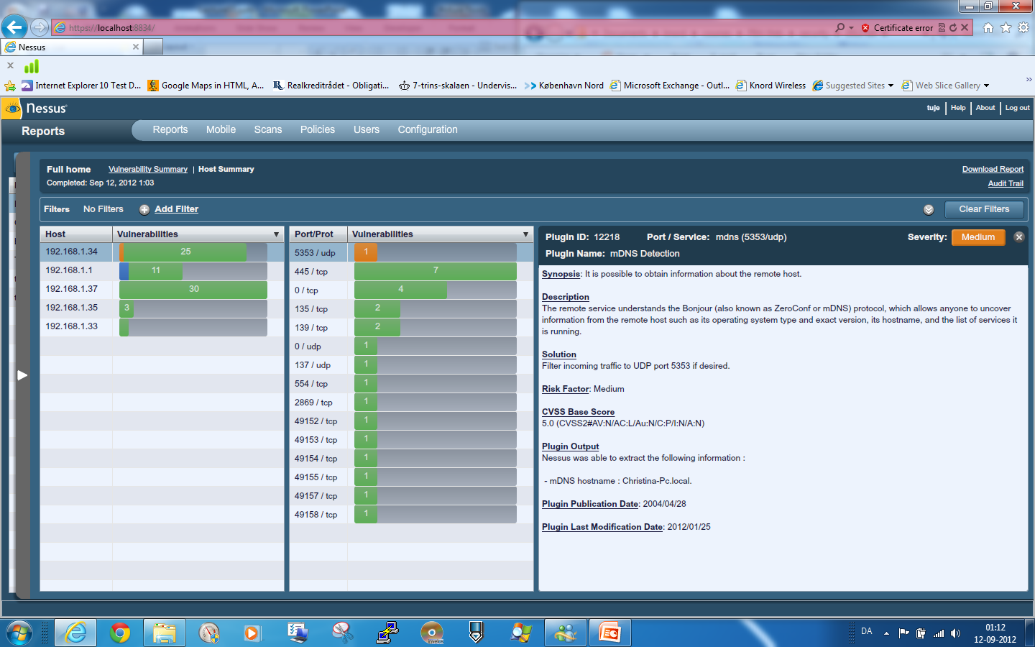
Nessus Scan Report

Slide 14
Student presentation
Web Application Firewalls – by Thomas Juul

Slide 15
Proxy server
- a server that acts as an intermediary for requests
Caching proxy server
Content-filtering web proxy
Anonymizing proxy server
Hostile proxy – eavesdropping

Slide 16
Exercise – use a open proxy
Navigate to a webpage with IP based limitation
Find and use a proxy to access the webpage
Was it easy?
Discuss the limitations
How about security?
Be aware – the proxy owner can still sniff out what you are sending.
Proxy example – you find one ☺

Slide 17
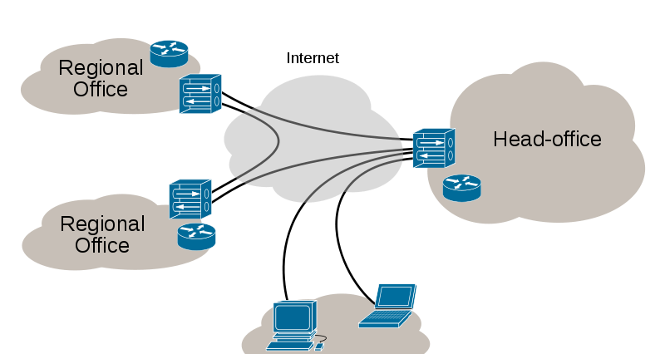
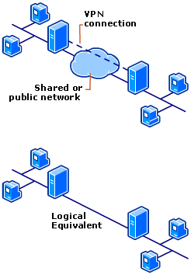
Virtual Private Network
Remote roaming users

Slide 18
Anonymous communication
Anonymizing proxy servers are not safe
What can we do?

Slide 19
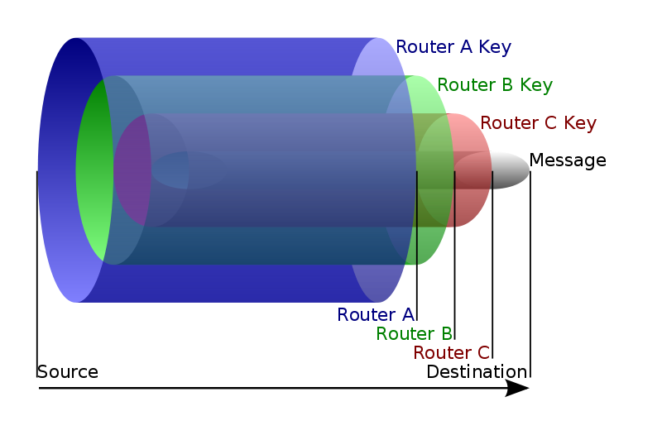
Onion routing
Anonymous communication over a computer network
Routing info is encoded using layers of encryption
Message travels from
source to destination
via a sequence of proxies,
which re-route messages
in an unpredictable path

Slide 20

Tor – The Onion Router
https://www.torproject.org

Slide 21
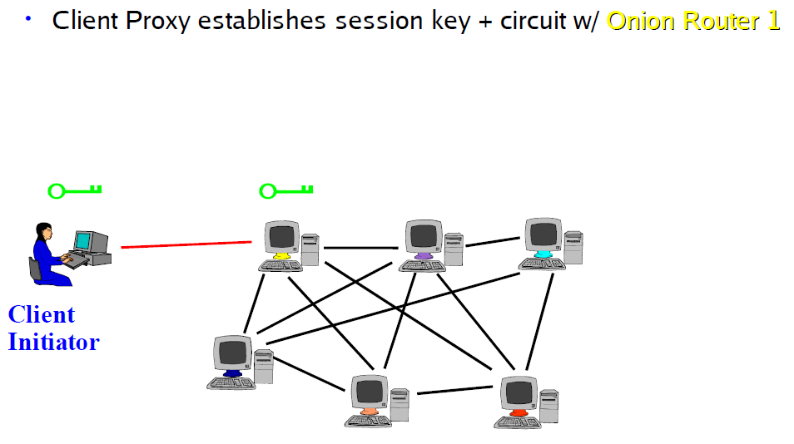
Tor Circuit Setup (from http://freehaven.net/~arma/wth1.pdf)

Slide 22
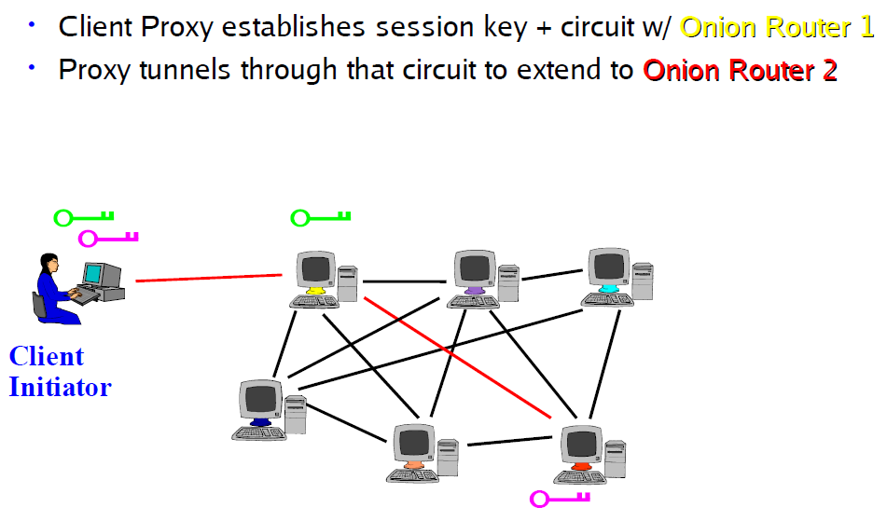
Tor Circuit Setup (from http://freehaven.net/~arma/wth1.pdf)

Slide 23
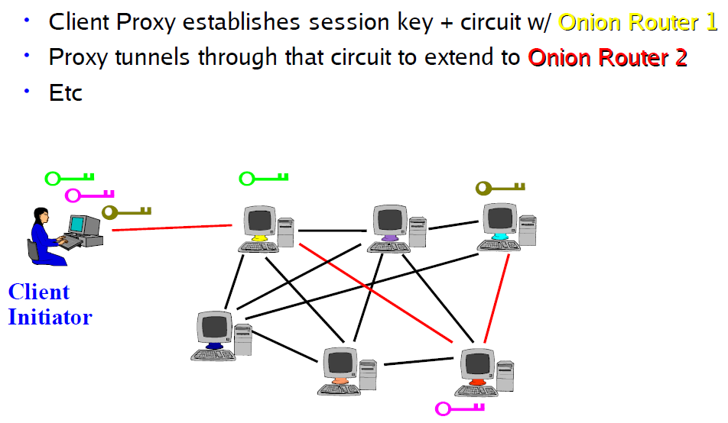
Tor Circuit Setup (from http://freehaven.net/~arma/wth1.pdf)

Slide 24
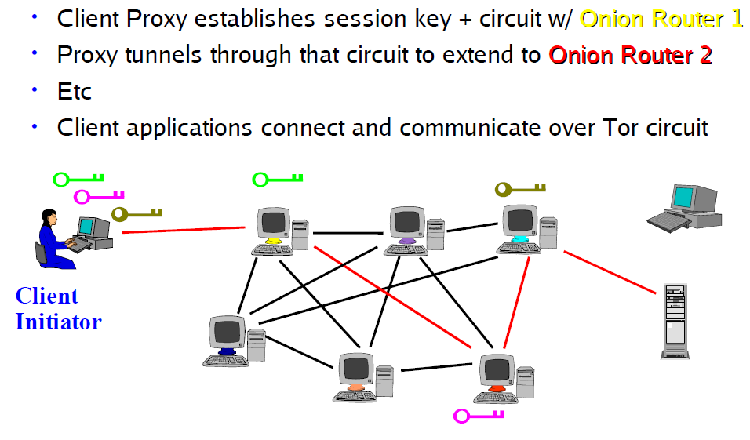
Tor Circuit Setup (from http://freehaven.net/~arma/wth1.pdf)

Slide 25
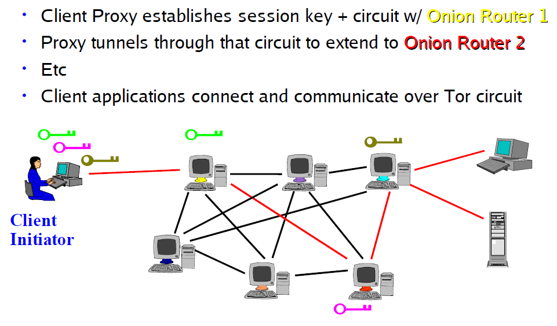
Tor Circuit Setup (from http://freehaven.net/~arma/wth1.pdf)

Slide 26
Is onion routing safe?
Sept. 2007 – DEranged Security reveals:
Tor exit nodes in 5 different locations in the world
Nodes was equipped with packet sniffer
Focusing on POP3 and IMAP traffic
Keyword and domain filter:
Gov, government, embassy, military, war, terrorism, passport, visa,…
Revealed passwords to email-accounts to Embassies and Governments around the world.
Lesson: Only use it for what it’s made for!!!

Slide 27
Exercise till next time
Do a vulnerability scanning of your own computers

Slide 28

Student presentation
Pen testing distrobutions by Jacob Kostecki

Slide 29
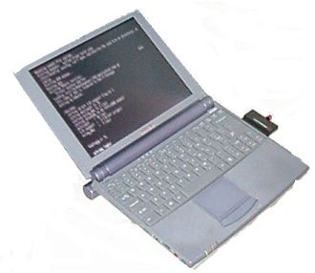
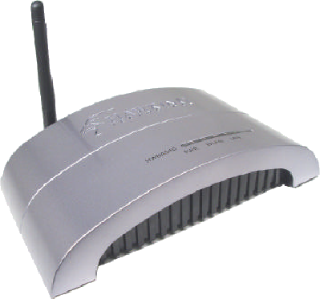
Wireless communication
A false sense of security is worse that a
true sense of insecurity

Slide 30
History
1888: Heinrich Herz produced the first radio waves
1899: Marconi sent a signal across the english channel
WW2: US Army used radio signals for data transmission
1970: Norman Abramson, University of Hawaii created ALOHnet – first packet based radio com. Network
1990, the 802.11 Working Group was established
1997, IEEE 802.11 was accepted as the standard data communication format for wireless LAN

Slide 31
IEEE 802.11
Designed to integrate with wired networks
Each device has a unique MAC address
- same as the wired ethernet

Slide 32
Communication modes
Ad-Hoc
Wireless communication without AP
Direct connection from outside attacker to laptop on a secure network
Bridge to secure LAN
Infrastructure
All clients associate with an AP
All communication goes through the AP

Slide 33
Threats in the Medium
Wireless networking is radio communications
Anybody within range can eavesdrop or inject traffic
No way to tell if someone is passively listening to your traffic
Encryption is needed to secure communication

Slide 34
Attack types
Passive
Eavesdropping
Traffic Analysis
Active
DoS
Modification of message
Masquerading
Replay

Slide 35
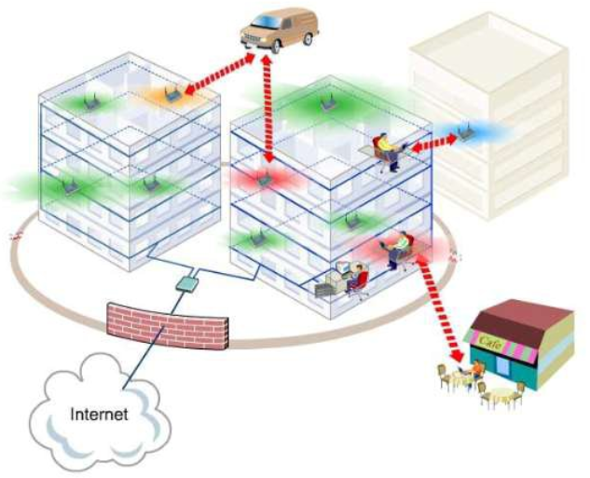
Wireless expand the perimiter
Signals outside the building
Wired firewalls
are ineffective
against WiFi threats

Slide 36
Rogue access points
Placed inside the security perimeter
Allow unauthorised access to the LAN
- like hanging a network cable out of the window
Malicious intent or ignorant employee
Placed outside the security perimeter
Emplyees could be tempted to circumvent security meassures
Could allow an attacker to use a victim as a bridge to the secure LAN

Slide 37
802.11b Security Features
Service Set Identifier (SSID)
Used to tell one AP from another
Beacon frames transmit SSID every few seconds
Beacon frames are plain text

Slide 38
Initiating communication
Open Key authentication
Need to supply correct SSID
Any wireless device can request authentication
Send authentication management frame with sender identity
Receiving station returns a frame to tell if it accept
Shared key authentication
Both partied must have a shared secret key
- key is shared over a independent secure channel
Communication is allowed if device can pass a Challenge response test

Slide 39
Encryption
WEP – Wired Equivalent Protocol
Use 40bit RC4 encryption
Intention: As secure as a wired network
has been compromised - open for attack!!!
WPA – Wi-Fi Protected Access
RC4 encryption
WPA2
AES encryption

Slide 40
Student presentation
Breaking WEP - presentation by Raul

Slide 41
Demo – breaking WEP
https://www.youtube.com/watch?v=Pyiz2Mct6dk

Slide 42
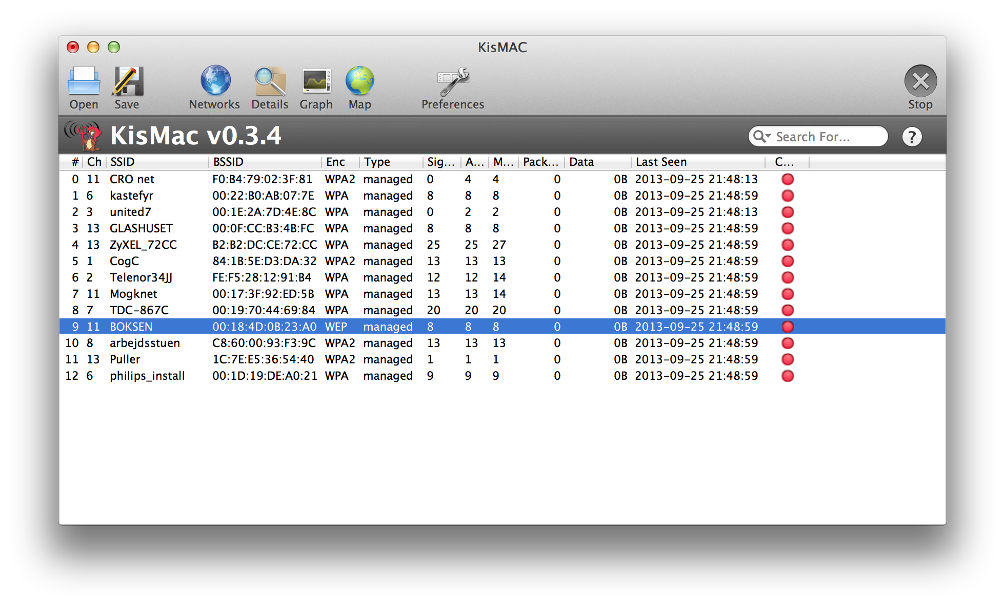
Targets are easily located
Default AP setup exposes SSID
Tools exist to extract hidden SSIDs from network traffic

Slide 43
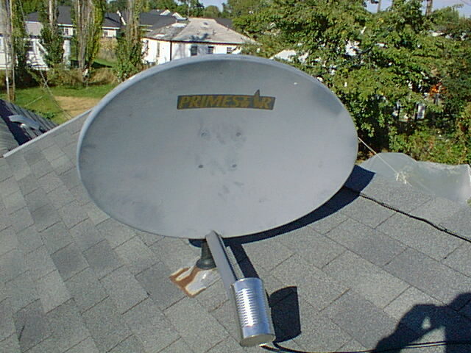
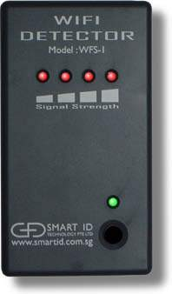
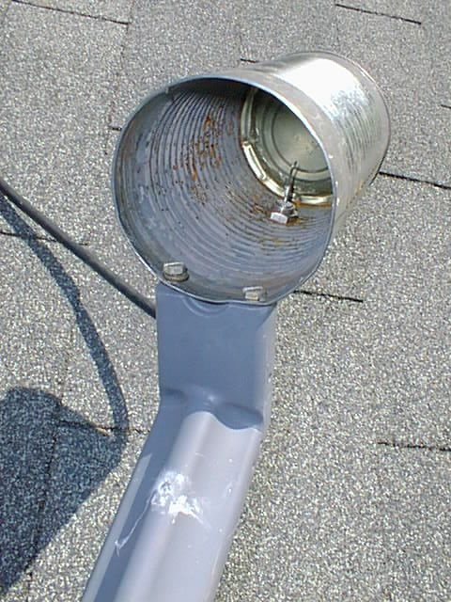
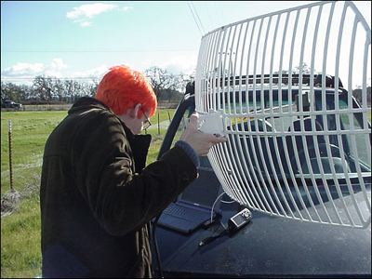
Tools
http://www.wlan.org.uk/antenna-page.html

Slide 44

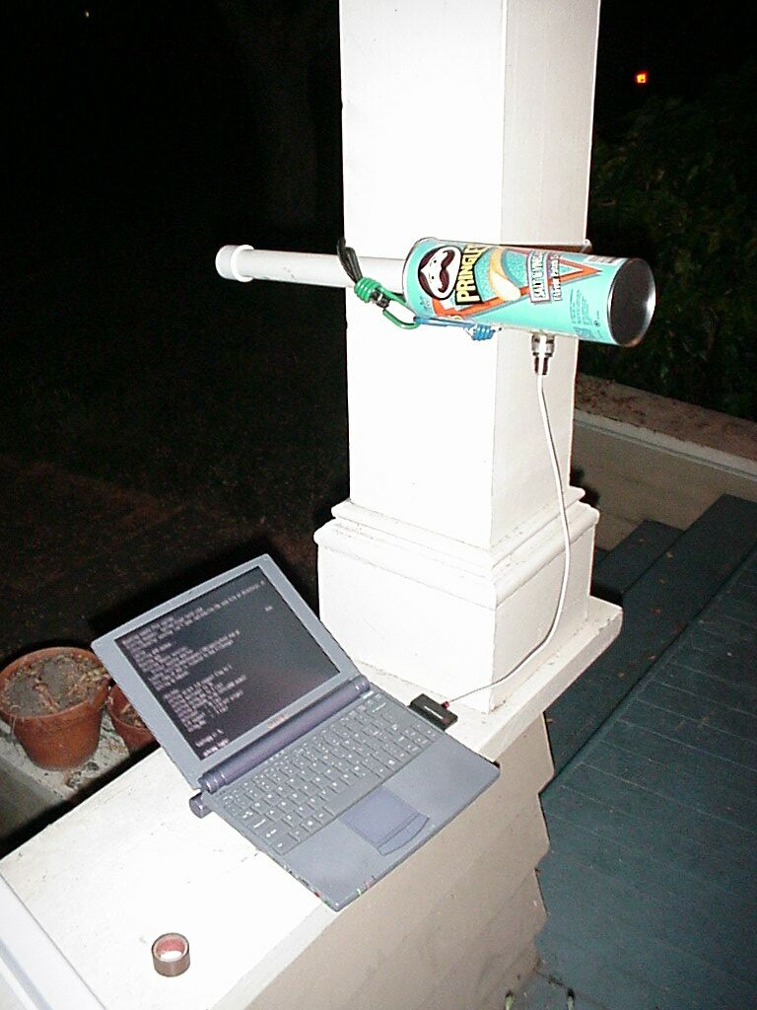
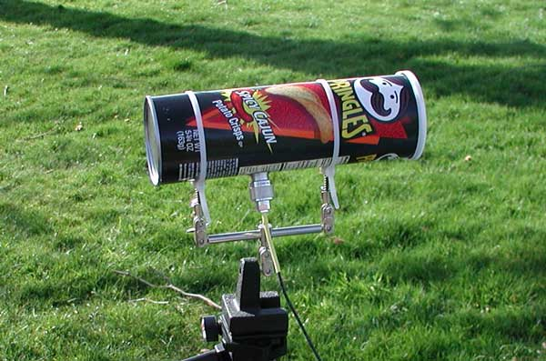

Geek tools - Cantennas

Slide 45

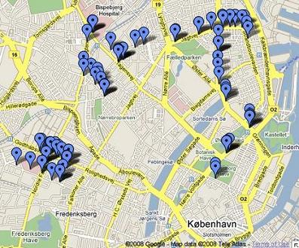
Wardriving Copenhagen
3 short testruns dec. 2008
Locate encrypted networks
3127 networks found
WEP : 23%
WPA : 77%
Article: http://www.viruslist.com/en/weblog?weblogid=208187609

Slide 46
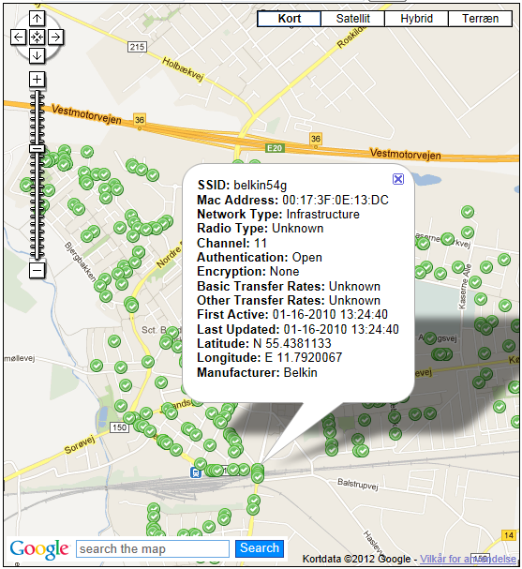
http://www.wifi-sikkerhed.dk/Wifi_omrader.html (*now closed)

Slide 47

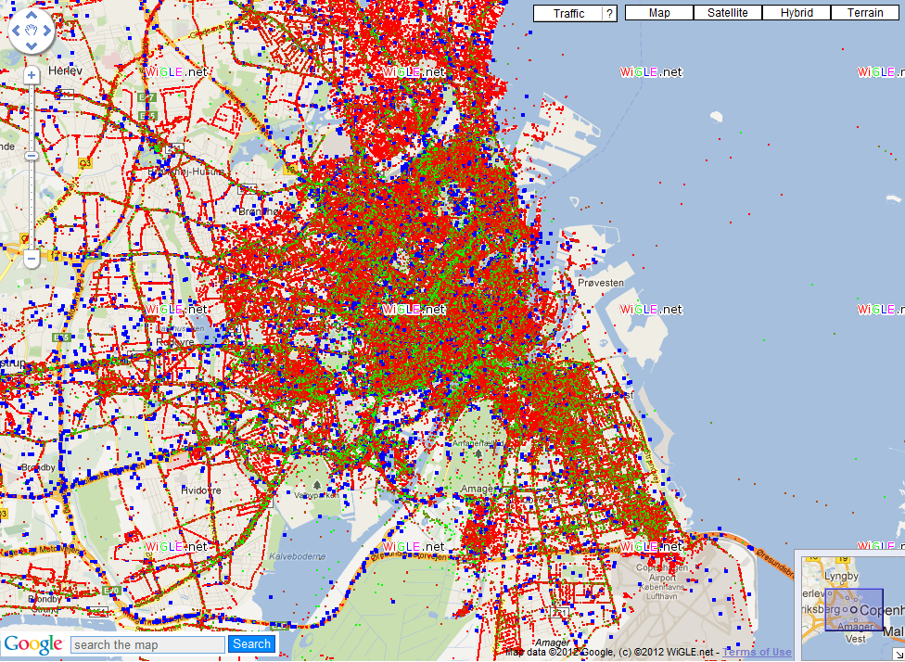
https://wigle.net/map?maplat=55.77036612440682&maplon=12.51227838650812&mapzoom=18

Slide 48
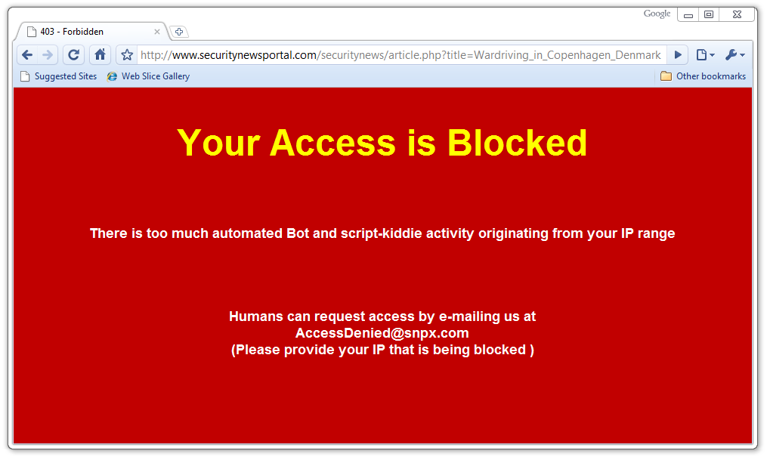
While looking for info…
Can you explain this? Is it possible to reach the page anyway?

Slide 49
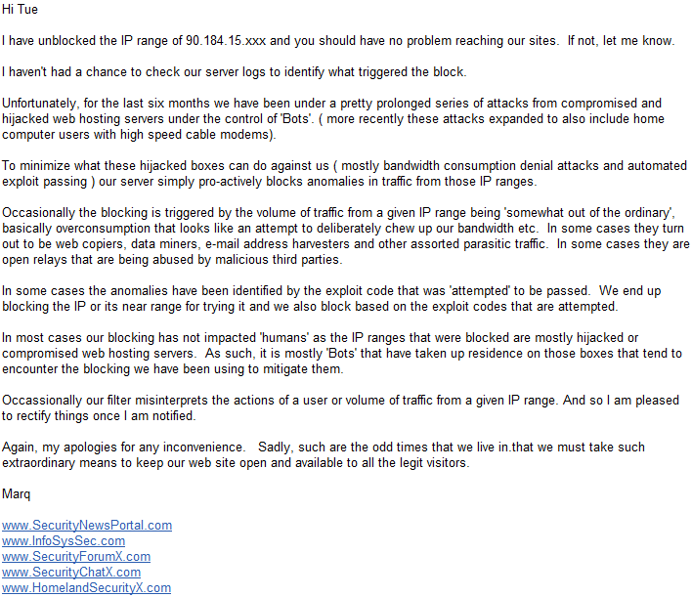

Slide 50
Securing wireless communication
Group exercise:
Investigate the following areas
The different types of encryption
MAC validation
The different types of authentication
Prepare a presentation for the class
How can it be used to secure wireless communication?
Relate to Confidentiality, Integrity & Availability
What would you recommend?
– why?
Is it safe? – explain.

Slide 51

Presentation ideas for next week
Prepare presentation for next class (5 minutes)
A: Wireless security in enterprise setups
Security threats and solutions
B: Wireless IPS system (ex. AirTight)
What can it do?
When will it be usefull?
Why?
C: Nessus scanning

Slide 52
Till next time
Info / literature / links on Fronter – keep updated!!!
Reading:
https://en.wikipedia.org/wiki/Group_Policy
NIST: Assessment of Access Control Systems (Chap 1-3)
http://csrc.nist.gov/publications/nistir/7316/NISTIR-7316.pdf
Computing is personal again with Windows 8 Dynamic Access Controls
Http://www.titus.com/titus-blog/2012/04/computing-is-personal-again-with-windows-8-dynamic-access-controls/
Sans Institute – The Disaster Recovery Plan
https://www.sans.org/reading-room/whitepapers/recovery/disaster-recovery-plan-1164
Find and comment on interesting news relevant for the weeks subjects
Help your classmates - share your findings via Fronter.
Create a link or upload files in: WEBSTUD > Resources > Security > 2016 Spring > Share

